Slide 1


Machine
Learning
Demystifying the World of Artificial Intelligence and Exploring Its Potential

Slide 2
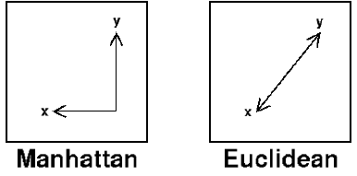
Manhattan vs Euclidean distance
Manhattan distance measures the path along grid lines
Euclidean distance measures the straight-line distance between two points
Machine Learning

Slide 3
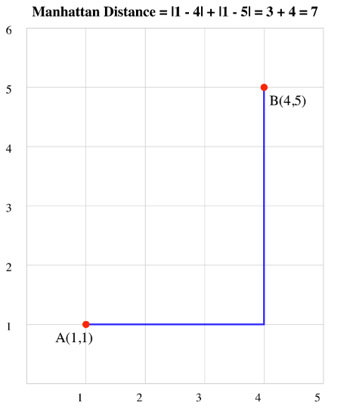
Manhattan vs Euclidean distance
Consider two points: A(1, 1) and B(4, 5):
Calculate |x₁ - x₂| = |1 - 4| = 3
Calculate |y₁ - y₂| = |1 - 5| = 4
Sum the results: 3 + 4 = 7
Therefore, the Manhattan distance between A and B is 7 units.
Machine Learning

Slide 4
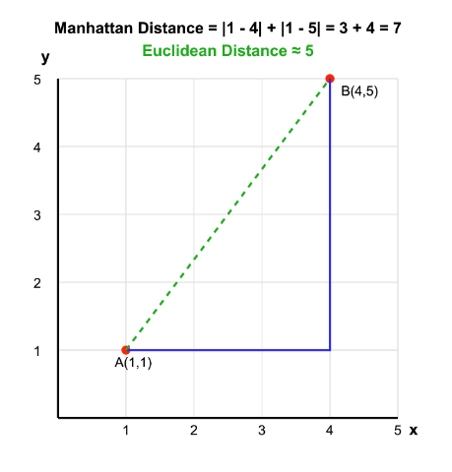
Manhattan vs Euclidean distance
Consider two points: A(1, 1) and B(4, 5):
Calculate |x₁ - x₂| = |1 - 4| = 3
Calculate |y₁ - y₂| = |1 - 5| = 4
Sum the results: 3 + 4 = 7
Therefore, the Manhattan distance between A and B is 7 units.
Euclidean distance: √((1-4)² + (1-5)²) = 5 units
Machine Learning

Slide 5
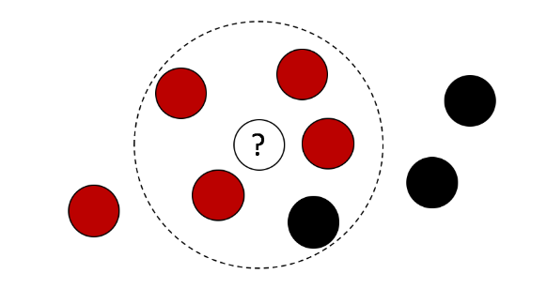
K - Nearest Neighbors (KNN)
a non-parametric, supervised learning classifier, which uses proximity to make classifications or predictions about the grouping of an individual data point.
Machine Learning

Slide 6
K - Nearest Neighbor [Classifier]
X X X
_{X} X
X
X
_{X X} X _{X}
X
X X
X
O
X
X X
X
X X @
_{X} X X _{X}
X _{X}
X
O O
X
O
_{O} O O _{O} O
O
O _{O} O
_{O} O O
O
_{O} O _{O} O
O
O
O
O O O O
Machine Learning

Slide 7
K - Nearest Neighbor [Classifier]
Problem:
We want to classify @
X X X
_{X} X
X
X
_{X X} X _{X}
X
X X
X
O
X
X X
X
X X @
_{X} X X _{X}
X _{X}
Steps:
X
O O
X
1- Define K parameter (ex: 5)
2- Get the nearest K data-points to @
3- Take votes from these points
O
_{O} O O _{O} O
O
O _{O} O
_{O} O O
O
_{O} O _{O} O
O
O
O
O O O O
Machine Learning

Slide 8
K - Nearest Neighbor [Classifier]
Problem:
We want to classify @
X X X
_{X} X
X
X
_{X X} X _{X}
X
X X
X
O
X
X X
X
X X @
_{X} X X _{X}
X _{X}
Steps:
X
O O
X
1- Define K parameter (ex: 5)
2- Get the nearest K data-points to @
3- Take votes from these points
O
_{O} O O _{O} O
O
O _{O} O
_{O} O O
O
_{O} O _{O} O
O
O
O
O O O O
Machine Learning

Slide 9
K - Nearest Neighbor [Classifier]
Problem:
We want to classify @
X X X
_{X} X
X
X
_{X X} X _{X}
X
X X
X
O
X
X X
X
X X @
_{X} X X _{X}
X _{X}
Steps:
X
O O
X
1- Define K parameter (ex: 5)
2- Get the nearest K data-points to @
3- Take votes from these points
O
_{O} O O _{O} O
O
O _{O} O
_{O} O O
O
_{O} O _{O} O
O
O
O
O O O O
Machine Learning

Slide 10
K - Nearest Neighbor [Regression]
Feature2
X _{X}
X
_{X}X
X X
X
X@X
X_{X X}
X ^{X}X _{X}
X _{X}
X _{X X}
X _{X}
X
X
X
X _{X}
Feature1
Machine Learning

Slide 11
K - Nearest Neighbor [Regression]
Problem:
We want to find the prediction of @
Feature2
X _{X}
X
_{X}X
X X
X
X@X
X_{X X}
Steps:
X ^{X}X _{X}
X _{X}
X _{X X}
X _{X}
1- Define K parameter (ex: 5)
X
X
2- Get the nearest K data-points to @
3- Take average from these points labels
X
X _{X}
Feature1
Machine Learning

Slide 12
K - Nearest Neighbor [Regression]
Problem:
We want to find the prediction of @
Feature2
X _{X}
X
_{X}X
X X
X
X@X
X_{X X}
Steps:
X ^{X}X _{X}
X _{X}
X _{X X}
X _{X}
1- Define K parameter (ex: 5)
X
2- Get the nearest K data-points to @
3- Take average from these points labels
_{X} X
X _{X}
Feature1
Machine Learning

Slide 13
K - Nearest Neighbor [Regression]
Problem:
We want to find the prediction of @
Feature2
X _{X}
X
_{X}X
X X
X
X@X
X_{X X}
Steps:
X ^{X}X _{X}
X _{X}
X _{X X}
X _{X}
1- Define K parameter (ex: 5)
X
2- Get the nearest K data-points to @
3- Take average from these points labels
_{X} X
Take average value of labels of these
5 points
X _{X}
Feature1
Machine Learning

Slide 14
K - Nearest Neighbor [Regression]
Problem:
We want to find the prediction of @
Feature2
X _{X}
X
_{X}X
X X
X
X@X
X_{X X}
Steps:
X ^{X}X _{X}
X _{X}
X _{X X}
X _{X}
1- Define K parameter (ex: 5)
X
2- Get the nearest K data-points to @
3- Take average from these points labels
_{X} X
Take average value of labels of these
5 points
X _{X}
Note: we drew features only without the label
Feature1
Machine Learning

Slide 15

K - Nearest Neighbor [Pros & Cons]
Pros:
Non training time.
Easy to implement
Non-linear performance
Cons:
High complexity with large data or number of features
Sensitive to noise
Machine Learning

Slide 16
THANK YOU!
Any Question!

